Slide 1
Evolution of Complexity COMP6026
Richard A. Watson
Natural Systems (SENSe)

Slide 2
Fitness Landscapes
Definition
Intuition
Properties
Examples: synthetic, biological
Complications

Slide 3
Some terminology
Genome/chromosome (an individual)
  A vector/string of genes
Gene = one variable in a genome
  E.g. the gene for height, eye colour
Allele
  The value of a gene – e.g. ‘tall’, ‘blue’, 0, 1, A, a
Locus
  The position of a gene in a genome
Genotype
  A type of genome – e.g.
  001010010111110
  AbcdEFgHiJk
0001111
0001111
1001000
1100011

Slide 4
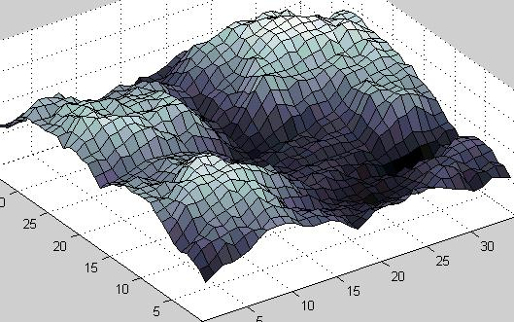
Definition of a fitness landscape
1) A set of genotypes
2) Neighbourhood – a way of arranging genotypes in a space such that
  Similar genotypes are close
  Different genotypes are far
  E.g. neighbouring genotypes differ by a single allele
3) Height of surface in this space = Fitness of each genotype
fitness
genotypes
genotypes

Slide 5
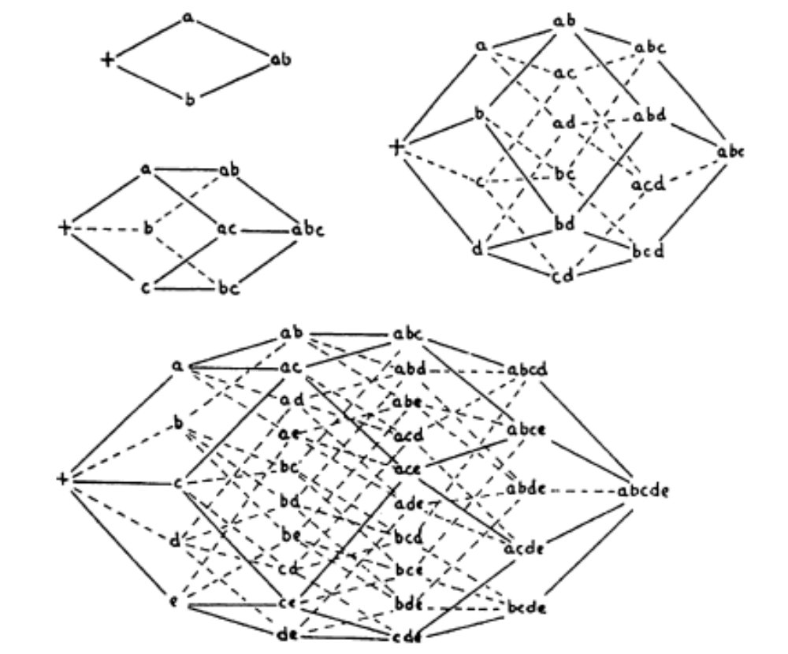
Wright’s genotype sequence space
i.e. distance = number of genetic changes
So number of dimensions= number of genes
But lets characterise it in a low dimensional representation

Slide 6
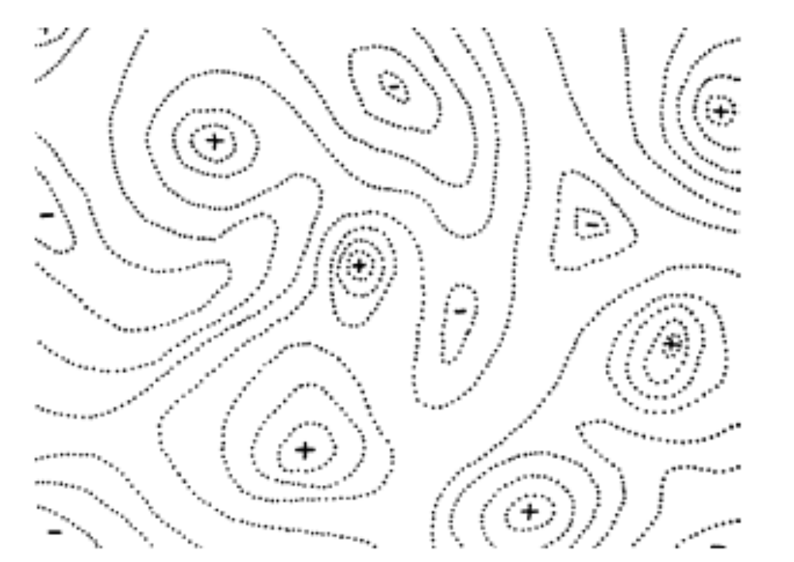
Wright’s fitness landscape
Contours of fitness define peaks and valleys in a two-dimensional fitness landscape

Slide 7
Intuition: Evolution ≈ hill climbing

Slide 8
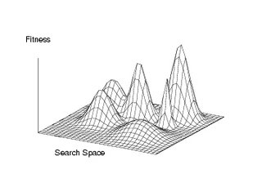
Properties of landscapes
Ruggedness/smoothness
  Are neighbouring points similar
  fitness
Local optima, global optima
  Points surrounded by lower
  fitness
Basins
  How likely is it I arrive at
  a particular optimum?
Neutrality and redundant mappings
  Is the gradient zero?
  Many genotypes to one fitness mappings
Paths of (monotonically) increasing fitness
  Do I need to go down in fitness? To cross a ‘Fitness valley’

Slide 9
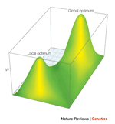
Gradualism and the ‘central problem of evolution’
“If it could be demonstrated that any complex organ existed which could not possibly have been formed by numerous, successive, slight modifications, my theory would absolutely break down.” (Darwin, 1859)
“the central problem of evolution . . . is that of a trial and error mechanism by which … a population may be carried across a saddle from one peak to another and perhaps higher one.” (Wright 1935)
≡ the central problem of all stochastic local search methods

Slide 10
Epistasis creates ruggedness
Epistasis: the fitness effect of an allele depends on the genetic context of that allele
More exactly: the change in fitness due to substituting one allele for another at one locus, is sensitive to the alleles that are present at other loci

Slide 11
Epistasis e.g.
NO epistasis
  F(ab)=1
  F(Ab)=1.1
  F(aB)=2
  F(AB)=2.1
  F(Ab)-F(ab)=0.1
  F(AB)-F(aB)=0.1
B
A
a
b

Slide 12
Epistasis e.g.
With Epistasis
  F(ab)=1
  F(Ab)=1.1
  F(aB)=2
  F(AB)=2.8
  F(Ab)-F(ab)=0.1
  F(AB)-F(aB)=0.8
B
A
a
b

Slide 13
Example synthetic landscapes
Functions of unitation
  One max, trap functions
(Epistasis networks)
Royal Roads and Staircases
NK landscapes
Long paths

Slide 14
Functions of ‘unitation’ (from many dimensions to one)
oneMax,
Max Ones,
counting ones
Where have we
seen this already?
Trap functions
A simple fitness valley
F(G)
Number of 1s in G
F(G)
Number of 1s in G

Slide 15
Epistasis networks
Nodes represent problem variables
Edges represent dependencies/epistasis between variables

Slide 16
b) NK-Landscapes Kauffman
N – number of variables
Each variable has a fitness contribution that is a function of its own state and k others.
b
a
c
0 1 1 1 0 0 1 1 0 0 1 0 1 1 1 0
abc f
000 0.6
001 0.1
010 0.8
011 0.2
100 0.6
101 0.1
110 0.8
111 0.2

Slide 17
d) NK landscapes – Kauffman
K=0 medium K high K

Slide 18
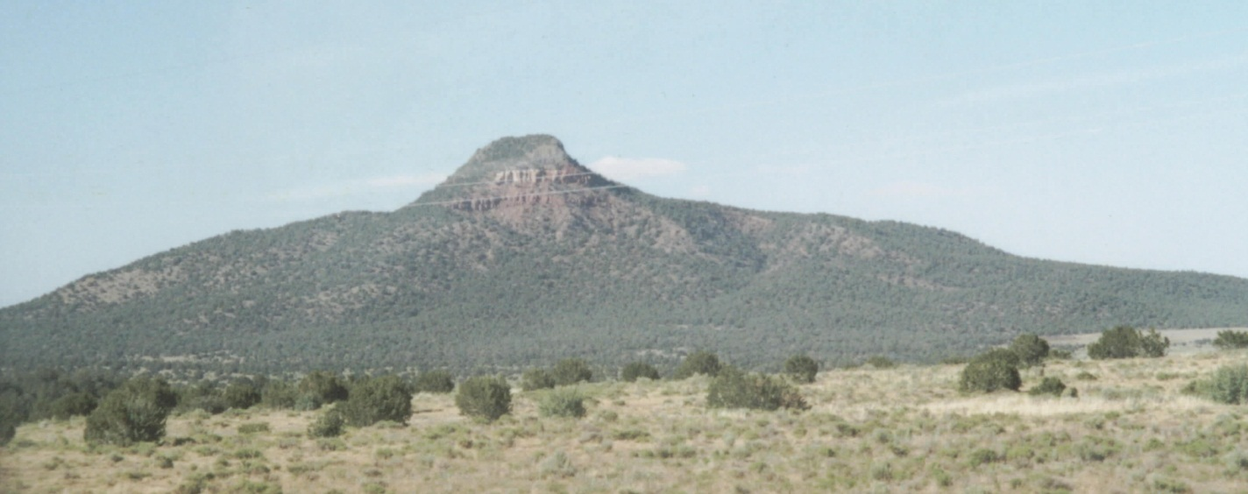
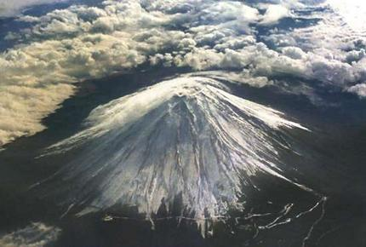
NK landscape, K=0 (“Mt. Fuji”)
Where have we seen this before?

Slide 19
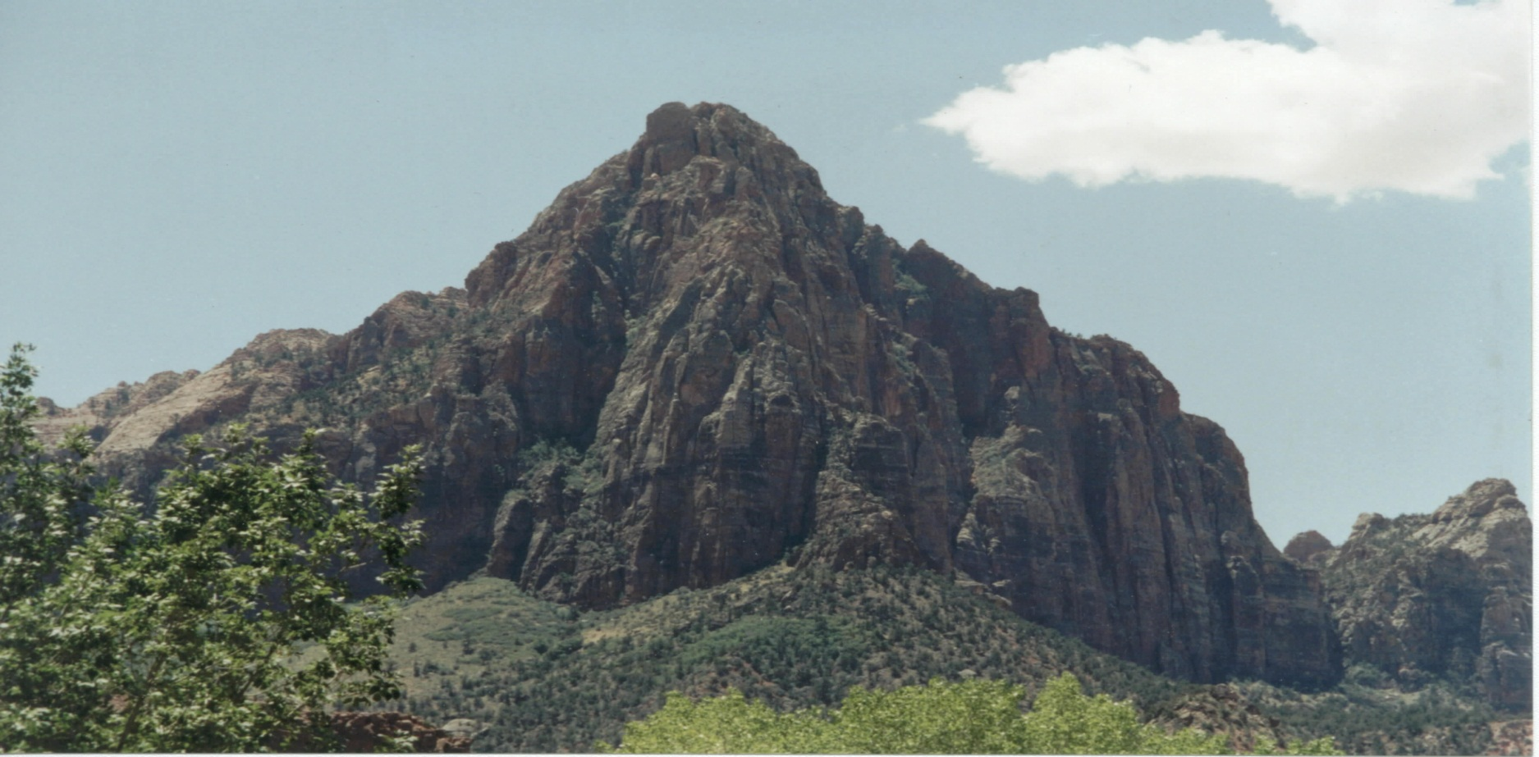
NK landscape, K=2

Slide 20
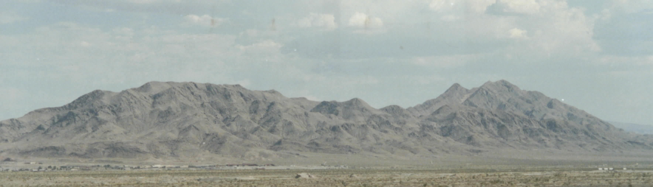
NK landscape, K=3

Slide 21
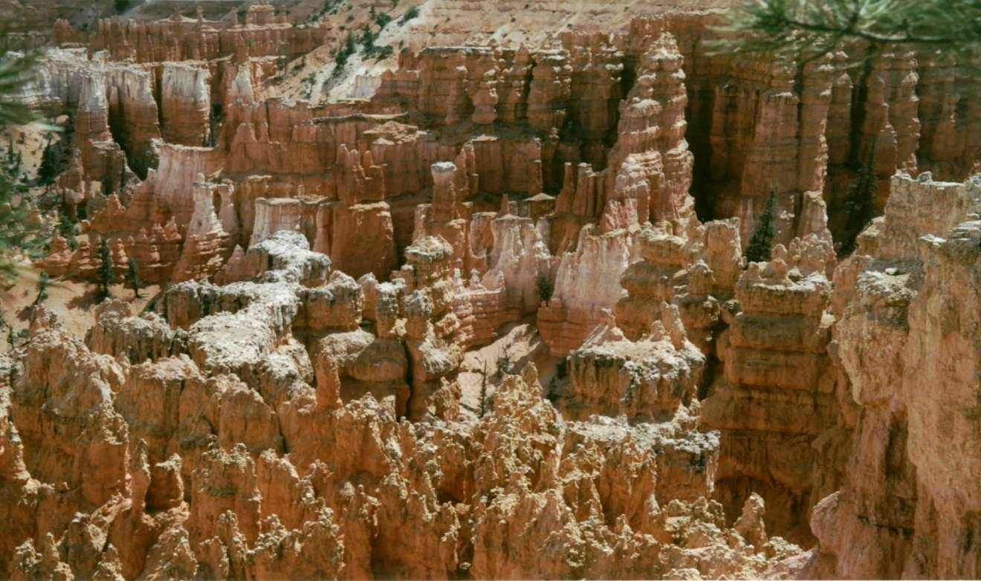
NK landscape, K=N-2

Slide 22
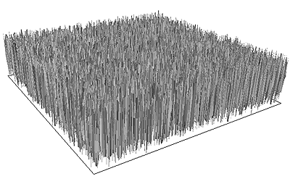
NK landscape, K=N-1

Slide 23
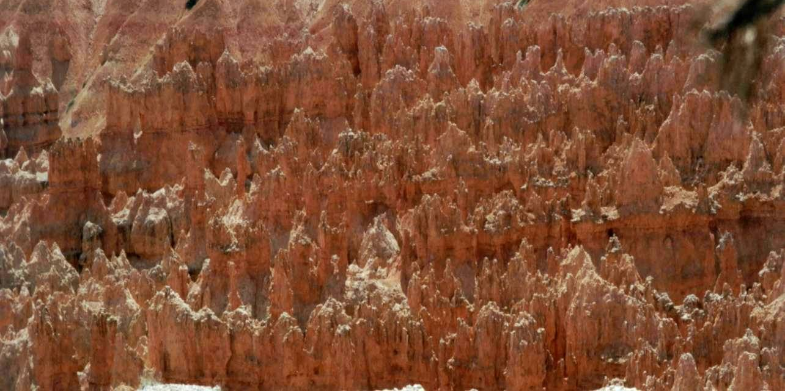
NK landscape, K=N-1

Slide 24
c) Royal Road (Mitchell, Forrest and Holland)
Separable sub-systems (building blocks) of variables
11111111 ******** ******** ******** 8
******** 11111111 ******** ******** 8
******** ******** 11111111 ******** 8
******** ******** ******** 11111111 8
11111111 11111111 ******** ******** 16
******** ******** 11111111 11111111 16
11111111 11111111 11111111 11111111 32
blocks can be solved one after the other in any order

Slide 25
d) Royal staircase (van Nimwegen and Crutchfield )
Royal road
Blocks can be solved one after the other
– but only in correct order
11111111 ******** ******** ******** 8
11111111 11111111 ******** ******** 16
11111111 11111111 11111111 ******** 24
11111111 11111111 11111111 11111111 32
‘portal genotypes’ from one neutral plateau to another

Slide 26
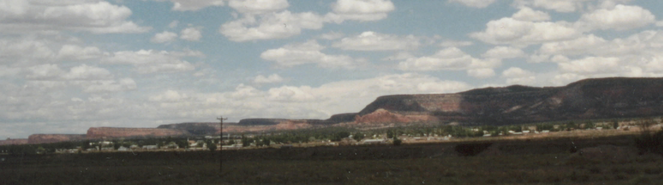
Royal Staircase

Slide 27
Path lengths
What happens to the length of an ‘adaptive walk’ as k increases?
What’s the longest that an adaptive walk could be? Could it be longer than N? What landscape would produce that?
00000 1
10000 2
11000 3
11100 4
11110 5
11111 6
01111 7
00111 8
00011 9
10011 10
“Long Path Problems” (Jeff Horn)

Slide 28
Tools for probing real/high-dimensional landscapes
  Adaptive walks from a peak (Martin Oates)
  Fitness distance correlation (Terry Jones)

Slide 29
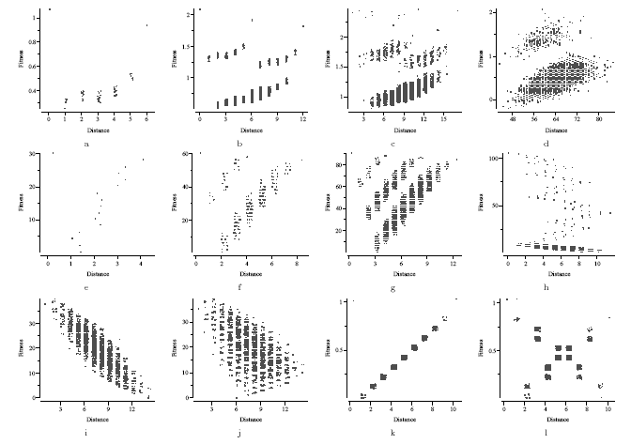
Fitness distance scatter plots (Jones 1995)
Trap 1
Trap 2
Trap 3
RR
Whitley’s trap 1
long
Whitley’s trap 2
Whitley’s trap 3
DeJong F3
DeJong F3
Deceptive 10 bit
Deceptive transformed

Slide 30
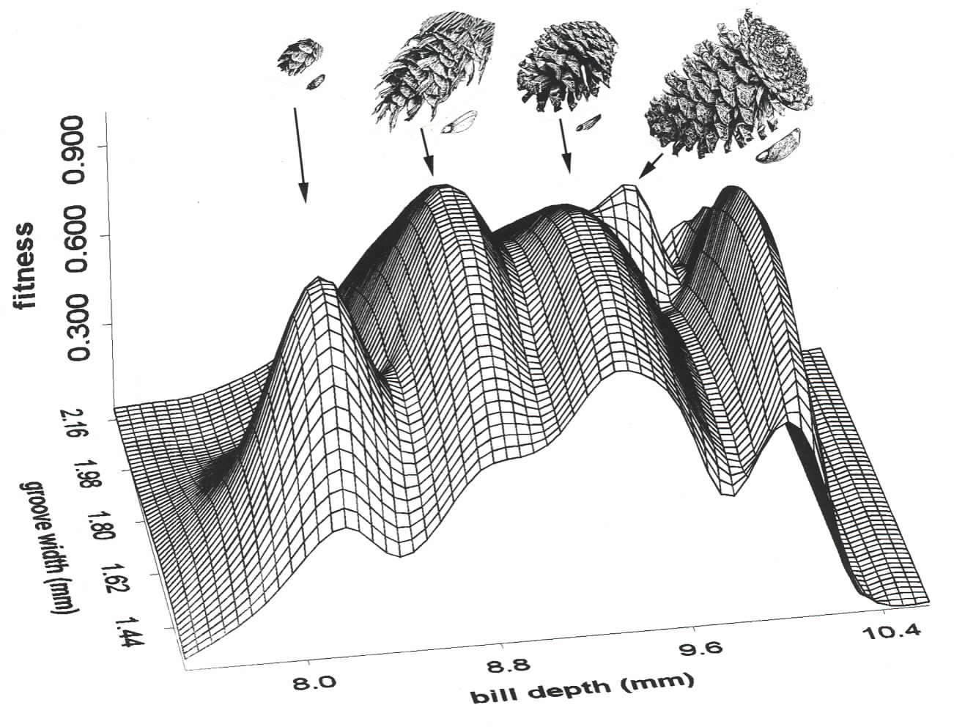
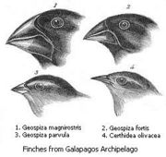
Biological Examples
Beaks match seeds
This is in ‘trait’ space

Slide 31
But consider the details
Nucleotide sequence (ACTGGGGACAC) → Amino acid sequence → protein shape → protein function → fitness contribution
And that fitness contribution is still epistatically dependent on other proteins
Small windows on real landscapes

Slide 32
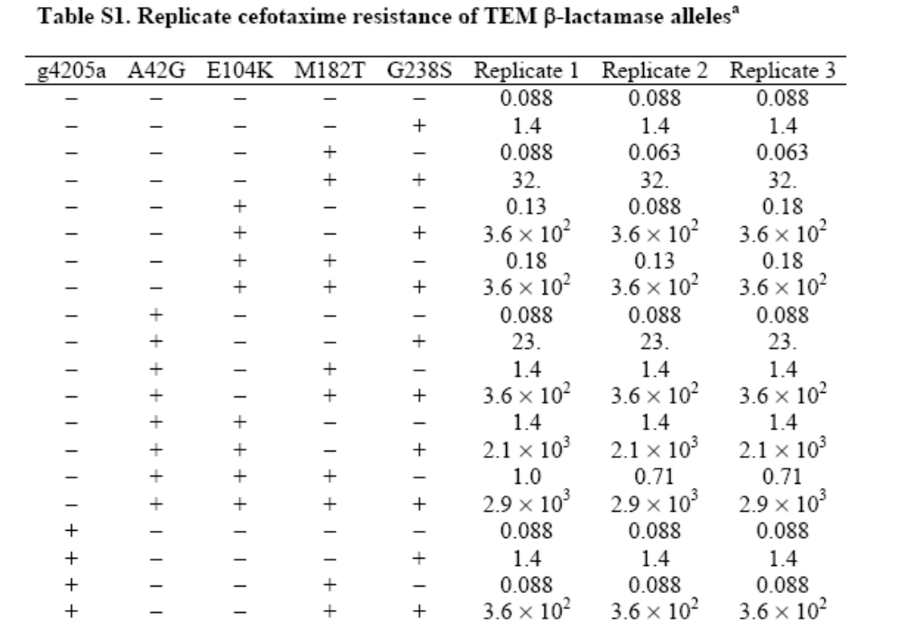
Evolution of antibacterial resistance (Weinreich, Science 2006)

Slide 33
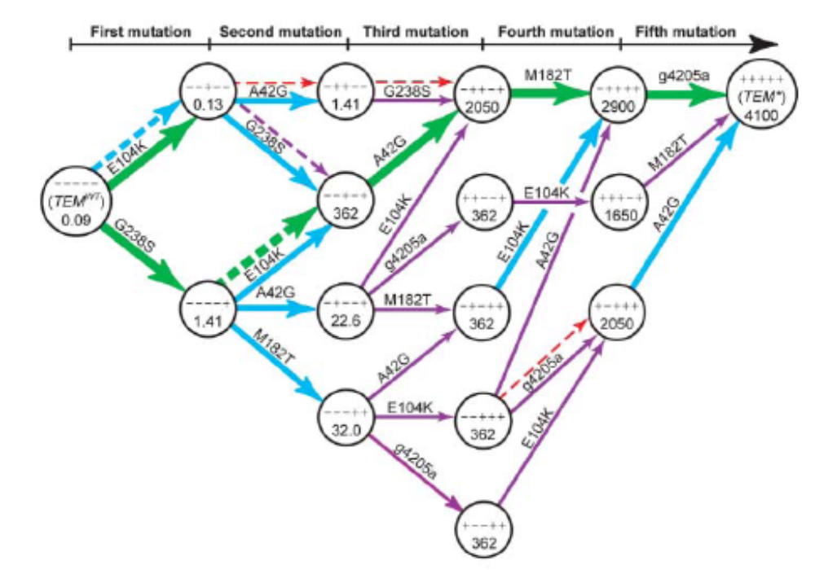
…Accessible evolutionary paths
Note that visualisation as a landscape seems hopeless

Slide 34

A series of one-step peeks into a high-dimensional space
What is the fitness landscape for an eye, or for squirrels

Slide 35
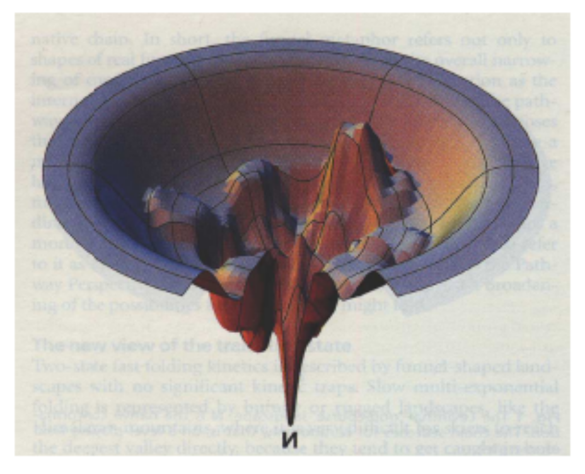
Protein folding
Protein folding ‘funnel’ landscape.
(Science 321: 784-786 (2008))
The folding of this protein may follow different trajectories, but we always end up with the same fold
Fold energy
Fold

Slide 36
And then it gets complicated…
Wright vs Fisher and the relevance of epistasis
Spaces and operators
  Individuals vs Populations
  Sexual populations vs asexual populations
Noise and dynamic landscapes
Coevolution
Designing a landscape

Slide 37
Sewell Wright vs Ronald Fisher
Fisher believed that populations are large and their movement in a fitness landscape is ‘deterministic’ – always uphill
So, even if there are other peaks/optima around – this is no concern of biologists
We may as well focus on understanding the approach of a population to a local peak – even if there is epistasis there’s no point in modelling it
Wright believed that epistasis and local optima were a big deal for natural populations and that they were biologically significant
How do populations get from one peak to another – Ans: by partially ignoring local fitness gradients – this can happen in small populations (or multi-deme populations)

Slide 38
Individuals vs Populations
Populations change by selection, mutation and recombination
A population has a distribution of genotypes
Selection enriches for fitter genotypes - The population ‘moves’ without any new mutations
What space does it move in?
A simplification
  Represent the composition of a population
  by a point in allele frequency space
Movements due to selection
in sexual populations move
to adjacent points in this
space…. (sometimes)
0 0 0 1 1 1 1
0 0 0 1 1 1 1
1 0 0 1 0 0 0
1 1 0 0 0 1 1
2 1 0 3 2 3 3
4 4 4 4 4 4 4

Slide 39
Neighbourhoods and variations
What does near and far mean in the neighbourhood of genotypes?
We’ve been assuming distance ~= number of genetic differences = Hamming distance
Consider: can I get from
  000000000000000 to
  000000001111111 in one step?
  By mutation?
  By crossover?
Then for sexual populations, these points might be ‘neighbouring’…?
(Terry Jones, PhD thesis, 1995)

Slide 40
Designing a landscape
If small changes to genotypes define neighbourhood of genotypes and properties of the landscape
Then for an engineer, it matters a lot how you encode your problem into genotypes
Different encodings → different movements are natural → different fitness landscapes result
→ ‘representations’ lecture

